Slide 1



IE6200 - SEC 06 - GROUP 5
CRM Sales Pipeline Report and Analytics
For
SUZHI Tech. Inc
FY 2020-2021 Report by Sakshi, Shubham and Subash

Slide 2



The Team
Helping the Suzhi Tech INC. Achieve its Revenue Goals
Sakshi Khadayate
Shubham Bhutada
Subash Rajaseelan
Data Enthusiast
(Love Numbers)
Critical Thinker
(Questions Everything)
Problem Solver
(in a way many don't understand)

Slide 3
Project Timeline
Project Start Date: October 23rd
Project End Date: December 6th
Task
October
November
December
Ideation
Brain Stroming
Data Collection
Data Cleaning
R - Coding
Project Report
Presentation

Slide 4
About
Our Client
10+ Global
offices
40000+ Paying
Customers
Suzhi Tech.Inc is a Global Enterprise B2B Cloud SaaS startup based out of India founded by
Mr. Aman in the year 2007.
5000+
Employees
4 Portfolio
Enterprise
Products
Raised 241M in Series A,B,C,D,E Funding

Slide 5





SUZHI'S JOURNEY
6
5
4
FUTURE PLAN
3
2021
2
2019
Go public by 2022 AMJ Quarter
Raise 500M in IPO
Crossed a milestone of 474 M with 20% YoY growth
4 portfolio Products with 5000+ Employees
10 Global offices with Fortune 500 clients from 150+ Countries
2016
Crossed a milestone of 300 M
Acquired an Analytics company
- Datapt and rebranded as Suzhi Analytics
Raised 120M in series E funding
1
Launched their third entreprise Product Suzhi SCM
Hit 8M in Sales the First Year of launch
Raised 80 M in Series D Funding
2014
2007
Launch of their Second Enterprise product Suzhi PLM
Hit 6M in sales the first Year
Raised a total of 40M in series A,B,C funding
The Startup was found by Mr.Aman in the month of November
Raised a seed funding of 1 M
Launch of their first Enterprise product Suzhi ERP
A brief history of
Suzhi Tech

Slide 6
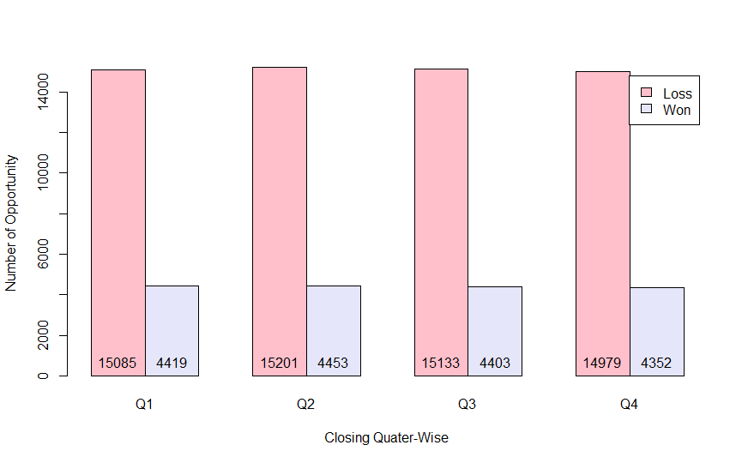
FY 2020-2021 Quater-Wise Sales Opportunities
Problem Statement
Their growth in the Indian Market is Stagnant and they have reached out to us to analyze their pipeline data of the Indian Market.

Slide 7
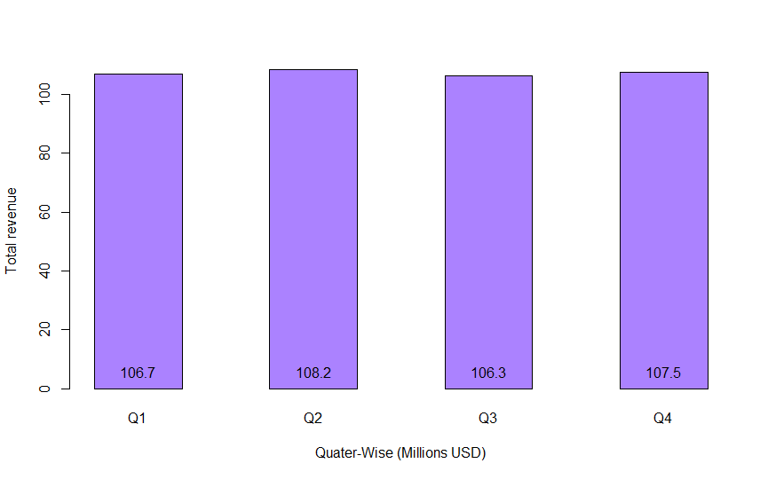
Revenue Growth
The Quarterly sales has not been growing from last 2 Quaters
Quarterly sales growth

Slide 8


Sales CRM Pipeline data of FY 2020-2021
(Q1, Q2, Q3, Q4)
What do we have from the Client-side?
1. Analyze data to find out
meaningful Sales Pipeline insights
2. Suggestions and recommendations
for IPO preparation
What’s our
Client Expecting?

Slide 9
What the client wants?
Ans.
Improve their performance in the India Market to prepare for IPO
What the client needs?
Ans.
Insights into their Sales Pipeline
Analytics to achieve their goals

Slide 10

Agenda
What this report will cover
Opportunity Insights
Analyze the Wins and Losses
Best Fitted Distribution
Joint Probability Analysis
Correlation Analysis
Sales Velocity & ARPU
Other Insights
Pipeline Insights
Analysis for Business Growth
Suggestions for IPO

Slide 11

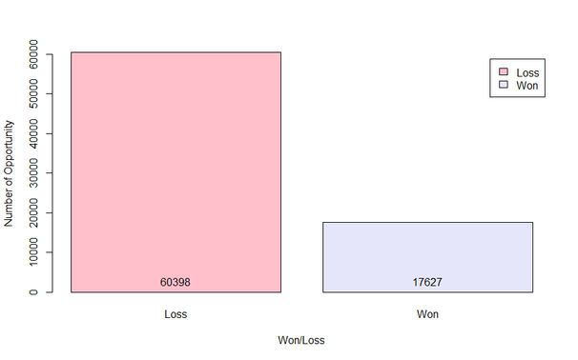
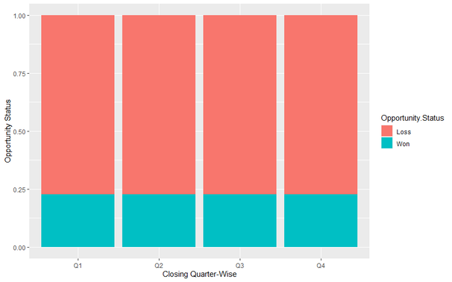

What's a
Sales Opportunities?
Opportunity insights
78,025
A sales opportunity is a qualified prospect who has a high probability of becoming a customer.
Total number of Opportunities Created in FY
17627 Won Deals
Conversion rate = 22.59%
No of Won & Loss Opportunities
Won Vs Lost Opportunity Quarter Wise

Slide 12

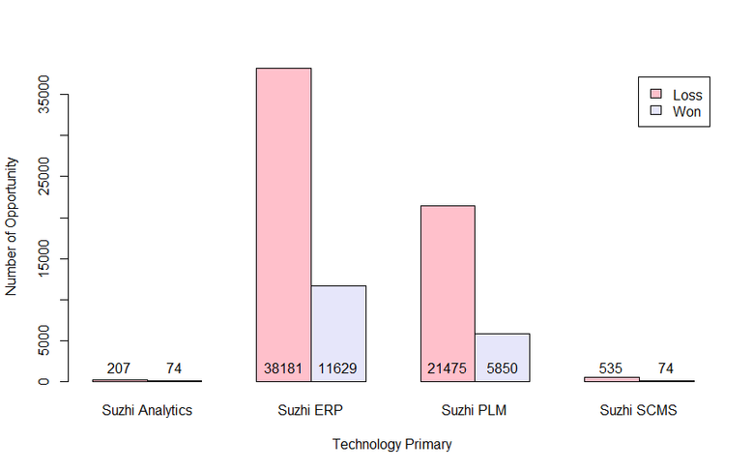
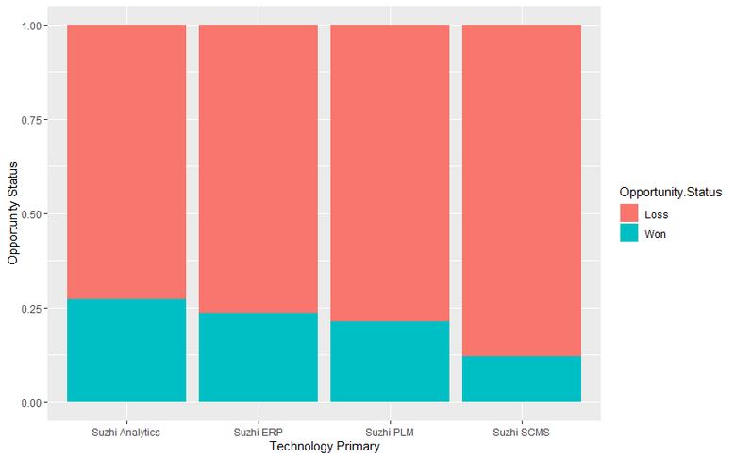
Win/Loss Report
Technology Primary
Important insight:
Suzhi ERP has the highest number of revenue
and won deals with 278.5 M USD and 11629 deals
Strengths:
Products Such as Suzhi Analytics and Suzhi SCM has high addressable market in India but not enough revenue with just a combined contribution of 0.8% of total revenue
Weaknesses:
Suzhi Analytics Product has the highest win percentage with 26.33% but accounts to only 0.3% of total revenue

Slide 13

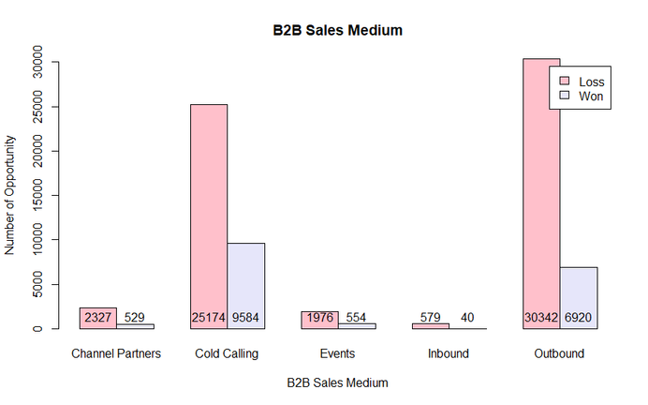
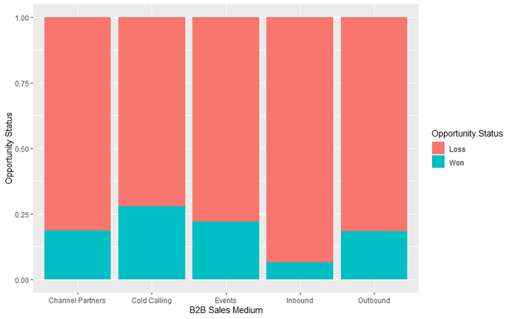
Win/Loss Report
B2B Sales Medium
Important insight:
49% of deals are generated through outbound and
second highest being cold calling with 44.5%
Strengths:
Cold calling has the highest conversions with 27.5 conversion rate
Weakness:
Not enough organic lead generation with just 0.8% inbound leads

Slide 14

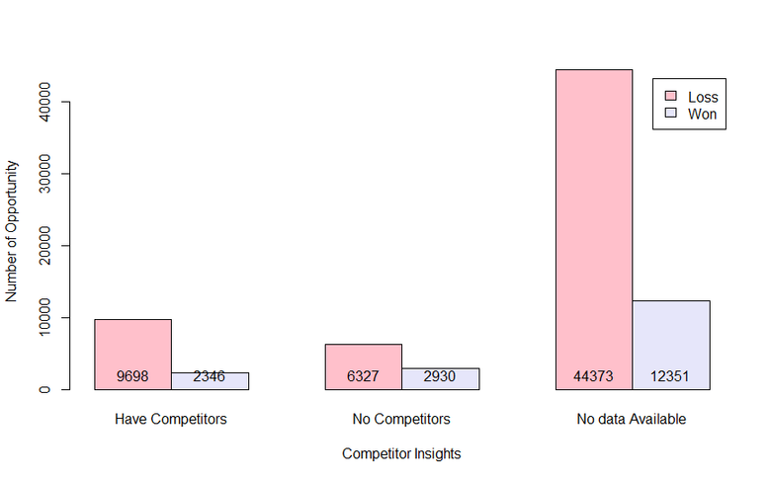
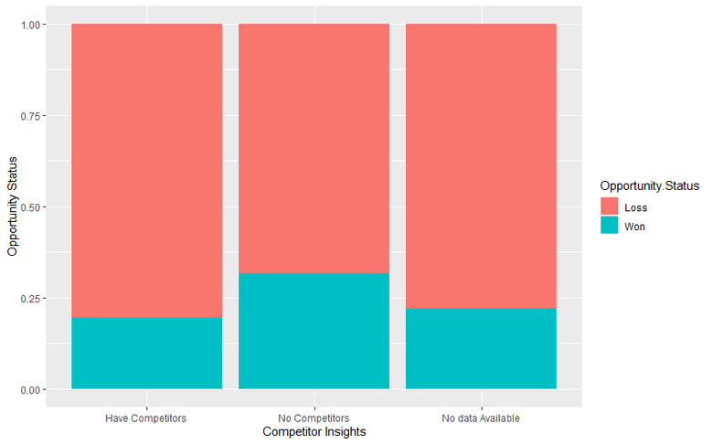
Win/Loss Report Cont.
Competitor Insights
Important insight:
More than 70% of the data has no intel about the competiors.
Strengths:
31.6% of of deals are won when there
are no competitors involved which is
29% more than the overall win percentage.
Weakness:
Only 19.5% of deals are won when
there are competitors involved which is 14% less then the overall win percentage

Slide 15
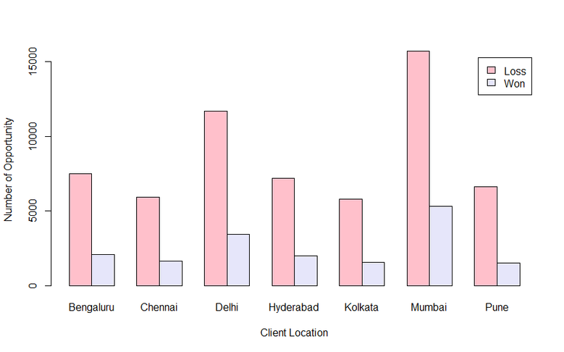
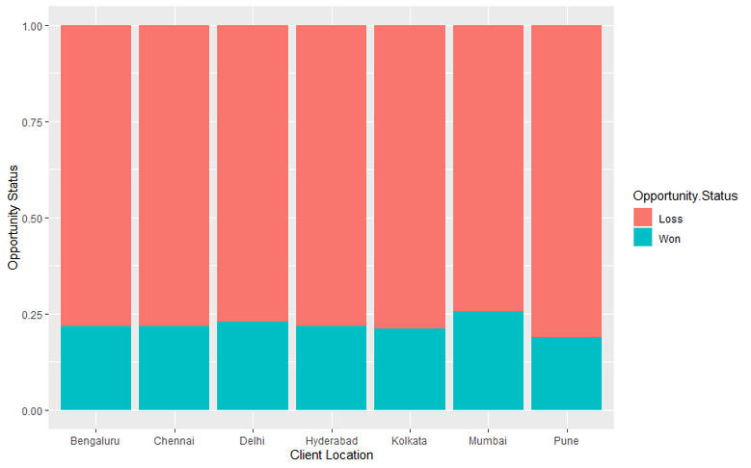
Win/Loss Report Cont.
Client Location
Mumbai is the highest performing market with 28.76%
of total revenue and 123.3 M USD
Strengths:
50% of the total revenue comes from just two cities Mumbai and Delhi
Weakness:
Not enough business from growing tech hubs
like Chennai and Kolkata with just 75.7M contributing
to just 17.6% of total revenue

Slide 16
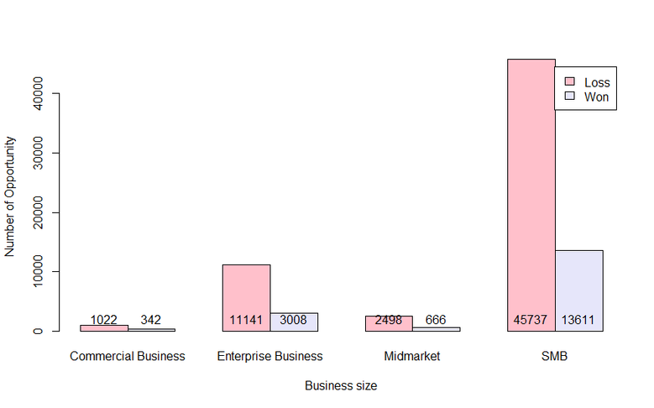
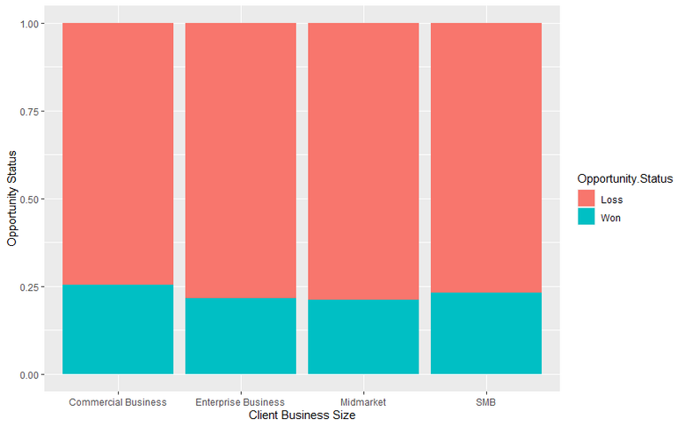
Win/Loss Report Cont.
Client Business Size Type
SMB customers buy more compared to other
customer segments 13611 Deals 77.2%
Strength:
The Enterprise segment with 5001+ employee size has the highest average revenue per unit (ARPU) of 27300 USD
Weakness:
Not enough business from large enterprise customers with just 19.2% revenue contribution

Slide 17
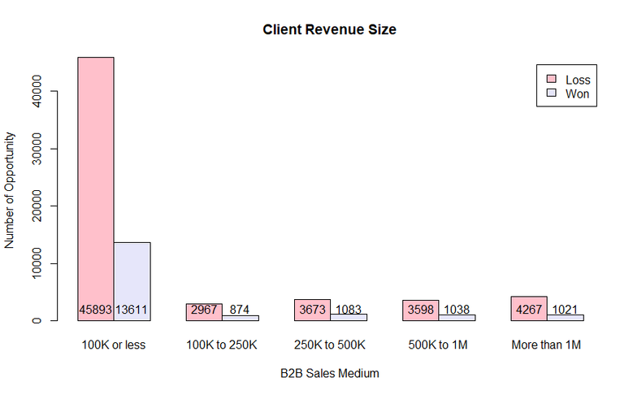
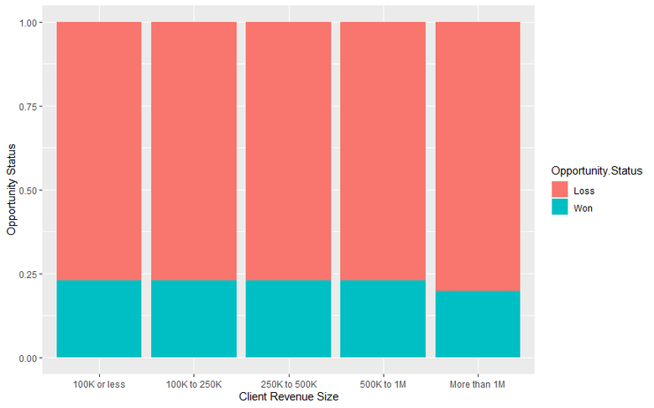
Win/Loss Report Cont.
Client Revenue Size
67.75% of our clients have a total revenue of less than 100k USD which means that these are start-ups with Venture Capital funding .
Strengths:
Suzhi products are preferred
by Indian Startups over other larger entities
Weakness:
The overall conversion in the Startup market in India is low with 17.5% conversion rate

Slide 18
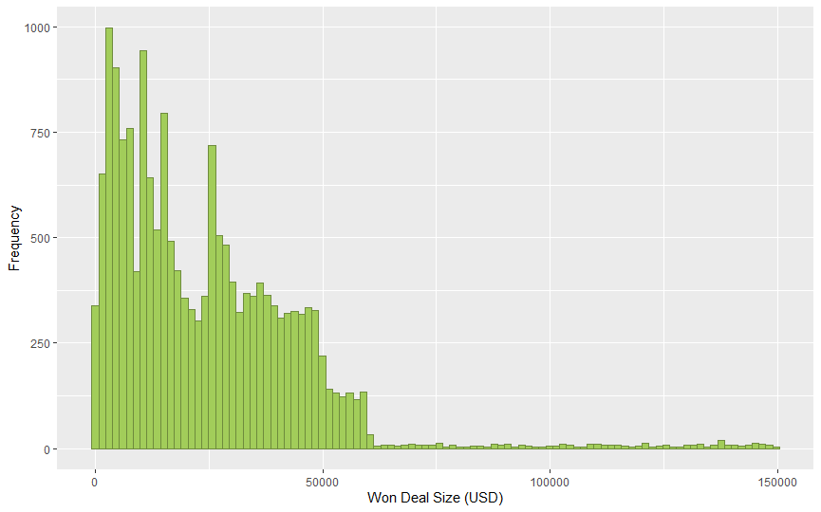
Best Fitted Distribution
Opportunity Size (Revenue of Won Deals in USD)
Discrete Data of Revenue values for Win Deals ranging from 0 to 150K USD
Visual and Statistical Analysis:
Data is best fitted in Negative Binomial Distribution

Slide 19
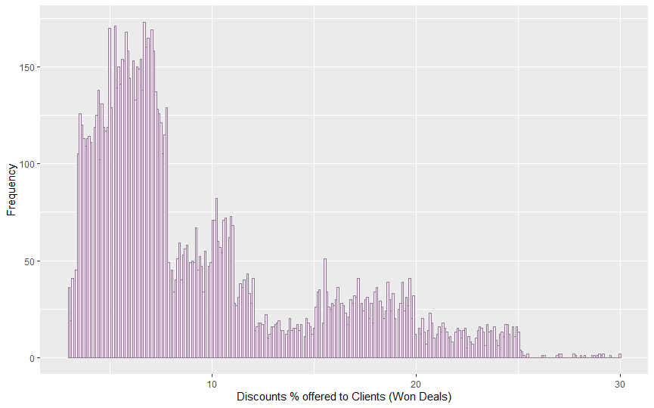
Best Fitted Distribution
Discounts % offered to Clients (Won Deals)
Continuous Data of Discounts offered to 65% of total Won opportunity clients ranges from 3 to 30%.
Visual and Statistical Analysis:
Data is best fitted in Gamma Distribution and Lognormal Distribution.

Slide 20
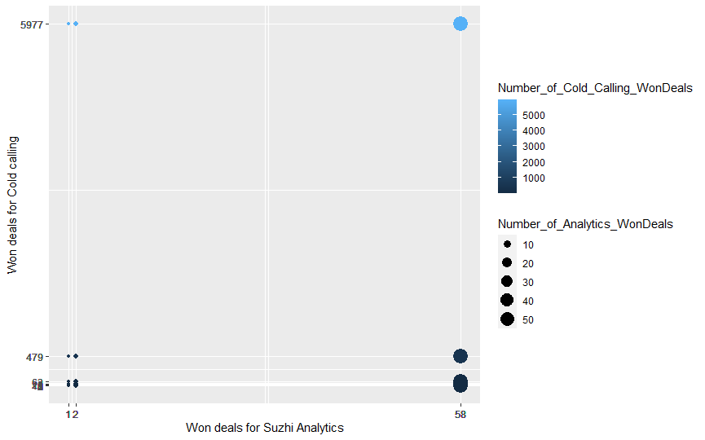
Joint Probability
Joint Probability for Won Deals for Technology Suzhi Analytics Vs B2B Sales Medium Cold Calling
Corelation Coefficient is 0.50

Slide 21
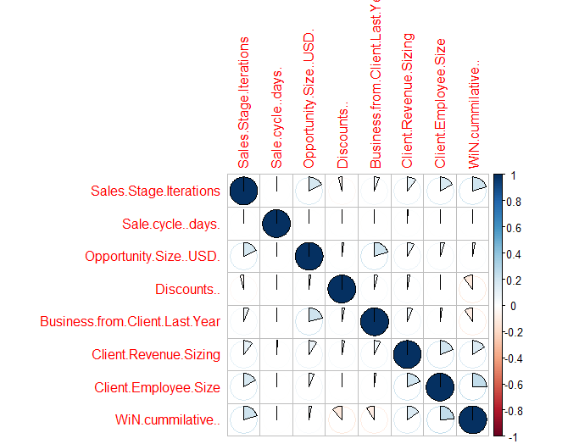
Correlation
Correlation plot suggests that there are no two entities which are forming a Strong Correlation.
The reasoning behind this is that in real life Sales pipeline data there are multiple factors affecting the data altogether.

Slide 22
Sampling & Hypothesis
Won Percentage/Probability
H0 = There is no significant difference between the Sample Won percentage and the population Won Percentage.
H1 = There is a significant difference between the Sample Won percentage and the population Won Percentage.
Sample Win Rate = 22.59% Population Win Rate = 23.1%
Proportion test P value 0.16 > 0.05
We fail to reject the null hypothesis which states that there is no significance difference in the sample won percentage and population won percentage.
Won Percentage Two Sample Proportion Test
H0 = There is no significant difference between the two Samples Won percentage Won Percentage.
H1 = There is a significant difference between the two Samples Won percentage Won Percentage.
Sample1 Win Rate = 22.52% Sample2 Win Rate = 23.87%
Proportion test P value 0.01 < 0.05
We reject the null hypothesis which states that there is a significance difference in the two Samples Won Percentage.

Slide 23
Sampling & Hypothesis
Revenue Size
H0 = There is no significant difference between the Sample mean & Population mean Revenue Size
H1 = There is significant difference between the Sample mean & Population mean Revenue Size
Sample Mean = 24080.47 USD Population Mean = 24322.78 USD
Z test P value = 0.24 > 0.05 T test P value 0.48 > 0.05
We fail to reject the null hypothesis which states that there is no significance difference in the Sample mean & Population mean Revenue Size.
Client Revenue Size
H0 = There is no significant difference between the Sample mean & Population mean client Revenue Size
H1 = There is significant difference between the Sample mean & Population mean Client Revenue Size
Sample Mean = 3068959 USD Population Mean = 2985636 USD
Z test P value = 0.64 > 0.05 T test P value 0.71 > 0.05
We fail to reject the null hypothesis which states that there is no significance difference in the the Sample mean & Population mean Client Revenue Size.

Slide 24
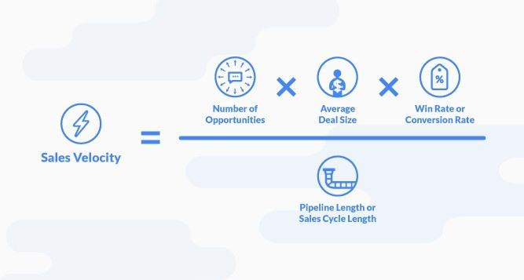
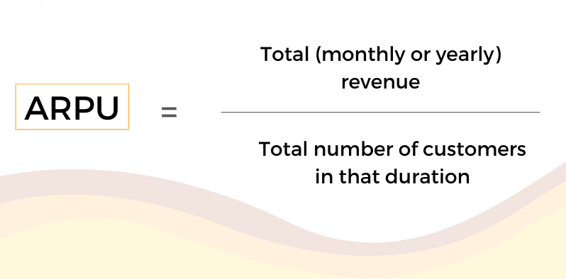
SALES METRICS
Sales Velocity & ARPU
Sales Velocity = 1,129,476.61246 USD / day ~ 1.13 Million USD/day
Average Revenue Per Unit (APRU) = 24322.78 USD/Unit

Slide 25


Healthy Insights
The customer retention rate is strong with 63.9%
The sales cycle is as per the industry standards with 86 days with the industry average of 84 days

Slide 26
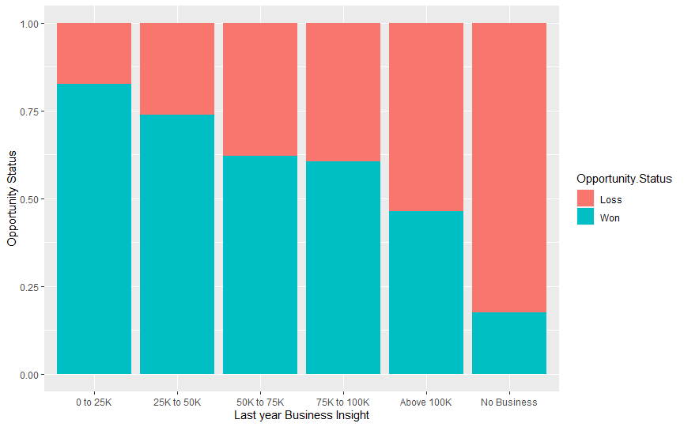
Analysis for Business Growth
Customer Retention
High chance of Winning a new deal if we had a business in the previous year i.e., Customer Retention Rate = 63.9% as compared to % Won deal for new client i.e, 17.3%

Slide 27
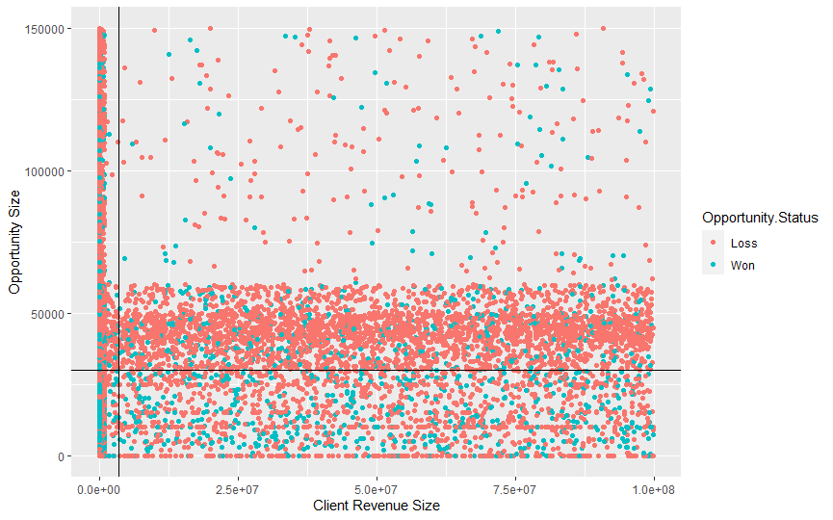
Analysis for Business Growth
Opportunity Size Vs Client Revenue Size
Opportunities available as well as converted are equally distributed among range of Clients Revenue Size.
Win% is more with opportunity Revenue less than mean value even though Number of Opportunities available are more right above the Mean of opportunity Revenue.

Slide 28
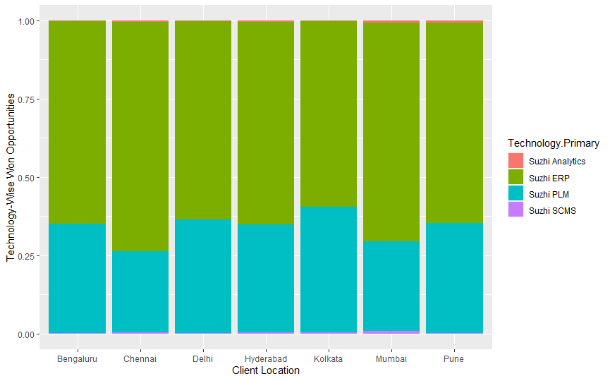
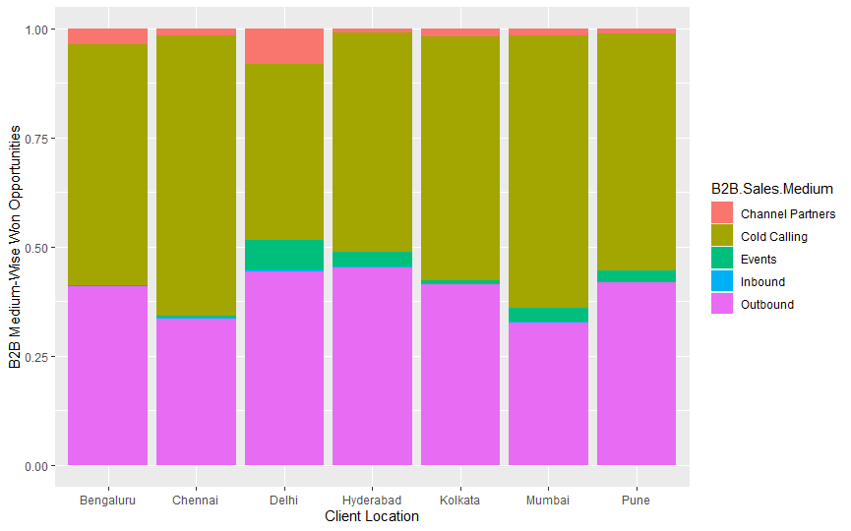
Analysis for Business Growth
Won opportunities Technology-wise for all Client location
Won opportunities B2B Sales Meduim-wise for all Client location
As inferred previously that Suzhi Analytics has the highest % Won but the Number of Opportunities is very less.
Cold Calling followed by Outbound Sales Medium Has Both high % Won as well as Number of Opportunities.

Slide 29
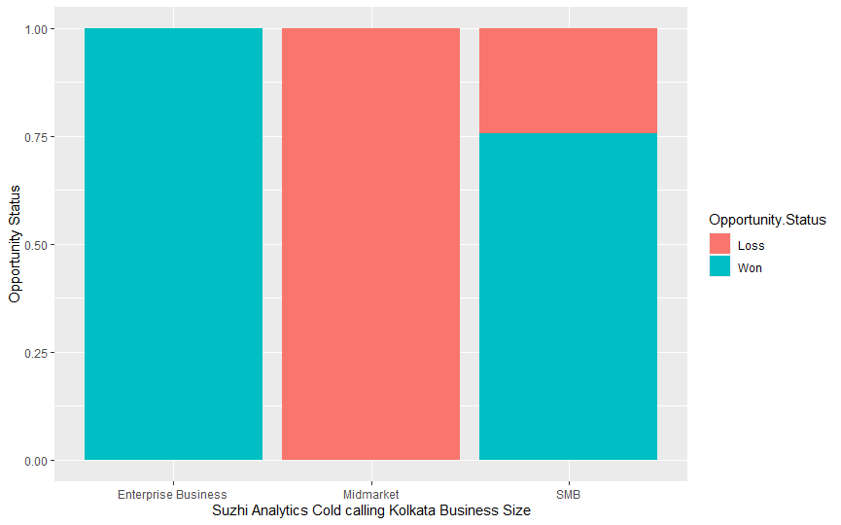
Analysis for Business Growth
100 % conversion rate -Suzhi Analytics with Cold Calling for Client Location Kolkata for Enterprise Business. To grow overall Win % Company should work on generating more leads in given criteria as this is best performing area.

Slide 30
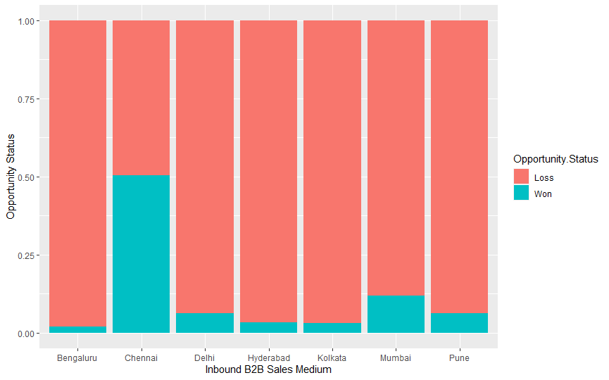
Analysis for Business Growth
Inbound B2B Sales medium
Inbound B2B sales medium has low customer conversion rates at all Client locations except Chennai, other locations teams should connect with the Chennai team to improve % Win, one way could be improving local SEO to increase conversions via organic lead generation which is major contributor to Inbound Sales Medium.

Slide 31
Suggestions for Improving Q4 Revenue of 2021-2022
01
02
03
04
05
Generating more organic leads
Start-Up
Programs
Emerging Products Focus
Sales Team Training
Maintain Lower Discounts
Focus more on inbound lead generation as inbound leads cost 61% less to acquire a customer and has 35% higher chances of converting an opportunity
Focus on startup markets like Bangaluru with an opportunity ecosystem of $42.7 billion for SaaS Products.
Coming up with Start-up Programs with software credits is an effective way of penetrating this market.
Focus on selling Suzhi Analytics as the Analytics Market in India is worth $25.5 Billion USD with high growth potential
Train the sales team to tackle and win deals that has competitor insights by providing Competitor battle cards and Objection-handling workshops
67% of our total revenue discounts are in the range 0-10 and hence offer lower discounts to improve ARPU

Slide 32




New Goals for upcoming Quater
Improve Inbound Lead generation by 10X
Acquire 6X more Startup Clients
Improve Product offerings and Product Marketing
of Suzhi Analytics
Prioratize creating Competitor battlecards and train the sales team
Start with offering stringent discounts on an increment of 5% +/- 0 .5%

Slide 33
References
https://www.kaggle.com/gauravduttakiit/sales-pipeline-conversion-at-a-saas-startup
https://www.r-graph-gallery.com/index.html
https://medium.com/@mygreatlearning/r-programming-tutorial-ac1ccddffda9
https://www.displayr.com/how-to-create-a-correlation-matrix-in-r/
https://www.youtube.com/watch?v=49fADBfcDD4&t=767s
Lab files from IE6200

Slide 34
Questions!

Slide 35

Group 5

